Slide 1
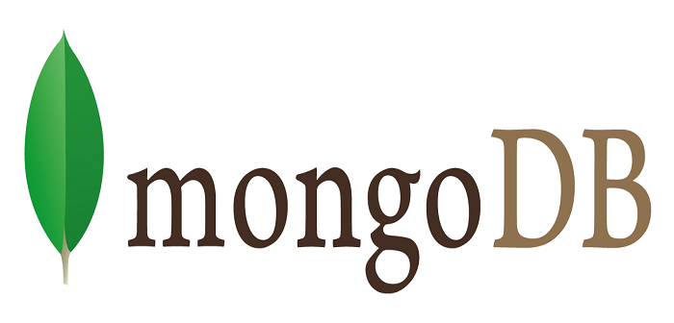
Full Stack Development
Administering User Accounts
By
K. Vishalini
22H51A05G2
CSE-D

Slide 2
MongoDB User Account Administration
Managing MongoDB user accounts is crucial for maintaining database security and controlling access to your data. Understanding how to create, manage, and secure user accounts is essential for any MongoDB administrator. This presentation will guide you through the fundamentals of MongoDB user account administration, covering key concepts, best practices, and troubleshooting tips.

Slide 3
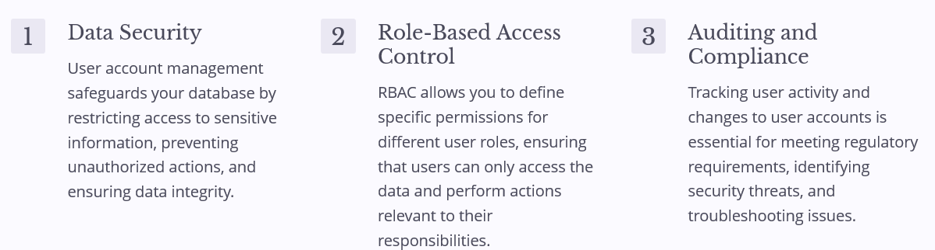
Importance of User Account Management

Slide 4
Creating User Accounts in MongoDB
MongoDB Shell
MongoDB Compass
Database Management Tools
Use the `createUser()` command in the MongoDB shell to create new user accounts. Specify the username, password, and database where the user will have access.
The MongoDB Compass GUI provides a user-friendly interface for managing user accounts. You can create new users, assign roles, and manage permissions visually.
Several third-party tools allow you to manage MongoDB user accounts from a centralized dashboard. These tools often offer advanced features such as password policy enforcement and user activity monitoring.

Slide 5
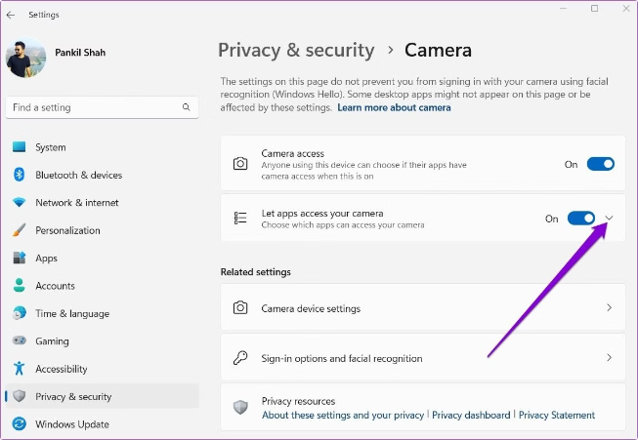
Assigning Roles and Permissions
Role
Description
read
Allows users to read data from a database.
write
Allows users to modify data in a database.
readWrite
Combines both read and write permissions.
dbAdmin
Provides administrative privileges over a specific database.
clusterAdmin
Grants administrative access to the entire MongoDB cluster.

Slide 6
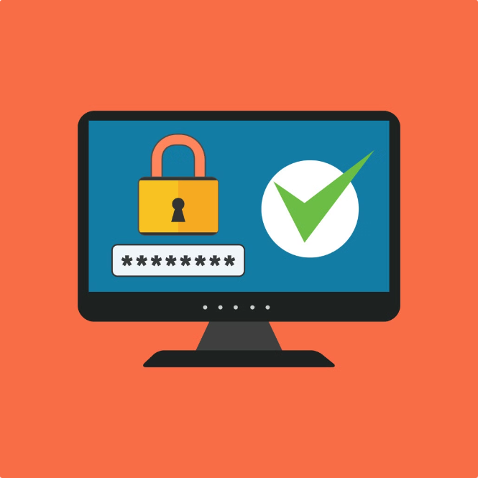
Handling Password Policies
1
Password Complexity
Set minimum length requirements, force the use of uppercase and lowercase letters, numbers, and special characters.
2
Password Expiration
Regularly require users to change their passwords. This reduces the risk of compromised accounts.
3
Password History
Prevent users from reusing old passwords. This adds another layer of security.
4
Password Storage
Hash passwords using secure algorithms to prevent unauthorized access. Avoid storing passwords in plain text.

Slide 7



Monitoring and Auditing User Activities
Log Analysis
Review logs for suspicious activity, including failed login attempts, unauthorized access, and data modification.
Security Monitoring Tools
Utilize security monitoring tools to track user activity, identify patterns, and analyze potential risks.
Alerts and Notifications
Set up alerts to notify administrators about
unusual activity or potential security breaches.

Slide 8




Backup and Restore User Account Data
Regular Backups
Create regular backups of your MongoDB data, including user accounts. This allows you to restore data in case of system failure or accidental deletion.
Backup Strategies
Explore different backup methods, such as logical backups, physical backups, or continuous backups. Choose the strategy that best meets your needs and security requirements.
Restore Procedures
Establish clear restore procedures to efficiently recover data from backups in case of emergencies. Test restore processes regularly to ensure data integrity.

Slide 9
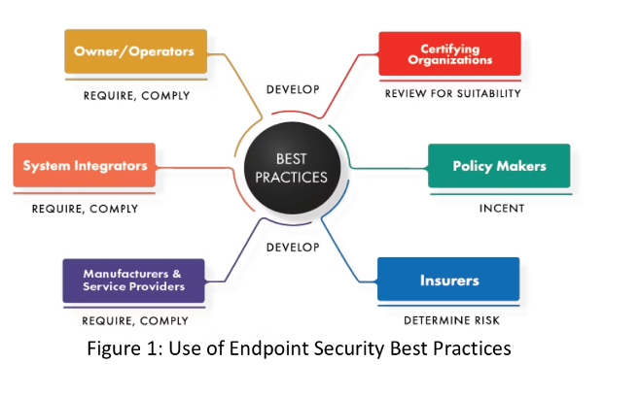
Best Practices and Troubleshooting
Strong Passwords
Least Privilege Principle
Encourage users to use strong passwords and avoid sharing their credentials with others. Implement password policies to enforce strong password practices.
Grant users the minimum permissions necessary to perform their job duties. This reduces the risk of unauthorized actions and data breaches.
Regular Auditing
Security Updates
Regularly review user activity logs and conduct security audits to identify vulnerabilities and enforce compliance.
Keep your MongoDB installation and related software updated with the latest security patches to mitigate known vulnerabilities.

Slide 10


Conclusion
By implementing proper user account management practices, you can ensure the security and integrity of your MongoDB database. Regularly review and update your security policies and procedures to stay ahead of evolving threats and maintain a robust security posture for your data.

Slide 11


